Slide 1
SECTION-II Graph, Hashing and Heap

Slide 2
Graphs:
Terminology and representation using Adjacency Matrix and Adjacency Lists, Graph Traversals and Application: BFS and DFS. Minimum Spanning tree: Prims and Kruskal’s Algorithm, Shortest Path Algorithms: Single Source All destinations, all pair shortest path algorithm, Topological Sort.
Hashing:
Hashing techniques, Hash table, Hash functions. Collision handling and Collision resolution techniques, Cuckoo Hashing. Dynamic Hashing: Motivation for Dynamic Hashing, Dynamic Hashing using Directories, directory less Dynamic Hashing. Bloom Filters Bloom Filter Design
Heap:
Amortized Analysis, Double Ended Priority queues, Leftist Trees, Binomial Heaps, Fibonacci Heaps, skew heaps, pairing heaps.

Slide 3
Introduction
A Graph is a non-linear data structure consisting of vertices and edges. The vertices are sometimes also referred to as nodes and the edges are lines or arcs that connect any two nodes in the graph.
Graph is composed of a set of vertices( V ) and a set of edges( E ). The graph is denoted by G(V, E).
Graph data structures are a powerful tool for representing and analyzing complex relationships between objects or entities. They are particularly useful in fields such as social network analysis, recommendation systems, and computer networks

Slide 4
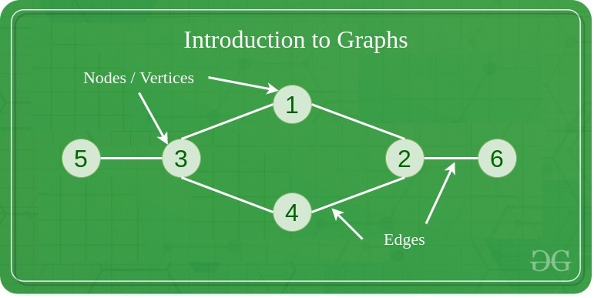
Components of a Graph
Vertices: Vertices are the fundamental units of the graph. Sometimes, vertices are also known as vertex or nodes. Every node/vertex can be labeled or unlabelled.
Edges: Edges are drawn or used to connect two nodes of the graph. It can be ordered pair of nodes in a directed graph. Edges can connect any two nodes in any possible way. There are no rules. Sometimes, edges are also known as arcs. Every edge can be labelled/unlabelled.

Slide 5
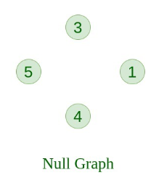
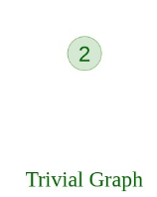
Types Of Graph
1. Null Graph
A graph is known as a null graph if there are no edges in the graph.
2. Trivial Graph
Graph having only a single vertex, it is also the smallest graph possible.

Slide 6
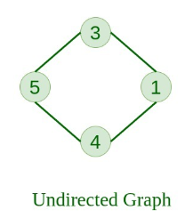
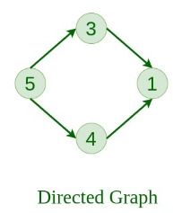
Types Of Graph
3. Undirected Graph
A graph in which edges do not have any direction. That is the nodes are unordered pairs in the definition of every edge.
4. Directed Graph
A graph in which edge has direction. That is the nodes are ordered pairs in the definition of every edge.

Slide 7
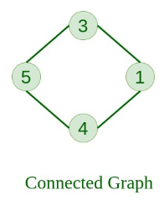
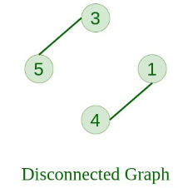
Types Of Graph
5. Connected Graph
The graph in which from one node we can visit any other node in the graph is known as a connected graph.
6. Disconnected Graph
The graph in which at least one node is not reachable from a node is known as a disconnected graph.

Slide 8
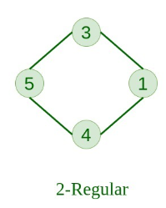
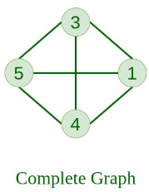
Types Of Graph
7. Regular Graph
The graph in which the degree of every vertex is equal to K is called K regular graph.
8. Complete Graph
The graph in which from each node there is an edge to each other node.

Slide 9
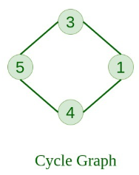
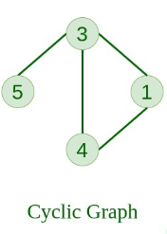
Types Of Graph
9. Cycle Graph
The graph in which the graph is a cycle in itself, the degree of each vertex is 2.
10. Cyclic Graph
A graph containing at least one cycle is known as a Cyclic graph.

Slide 10
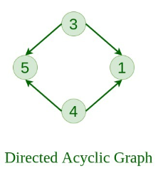
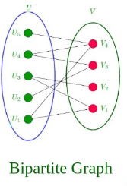
Types Of Graph
11. Directed Acyclic Graph
A Directed Graph that does not contain any cycle.
12. Bipartite Graph
A graph in which vertex can be divided into two sets such that vertex in each set does not contain any edge between them.

Slide 11
Types Of Graph
13. Weighted Graph
A graph in which the edges are already specified with suitable weight is known as a weighted graph.
Weighted graphs can be further classified as directed weighted graphs and undirected weighted graphs.

Slide 12
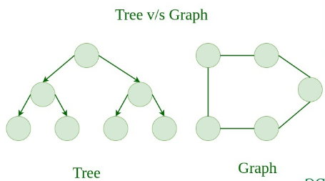
Tree v/s Graph
Trees are the restricted types of graphs. Every tree will always be a graph but not all graphs will be trees. Linked List, Trees, and Heaps all are special cases of graphs.

Slide 13
Representation of Graphs
There are two ways to store a graph:
Adjacency Matrix
Adjacency List

Slide 14
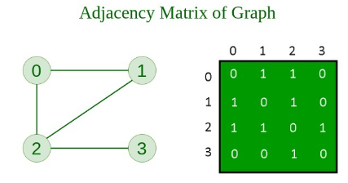
Adjacency Matrix
In this method, the graph is stored in the form of the 2D matrix where rows and columns denote vertices. Each entry in the matrix represents the weight of the edge between those vertices.

Slide 15
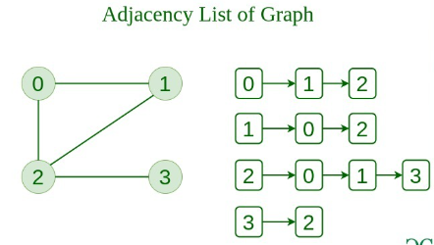
Adjacency List
This graph is represented as a collection of linked lists. There is an array of pointer which points to the edges connected to that vertex.

Slide 16
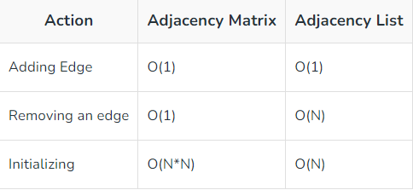
Comparison between Adjacency Matrix and Adjacency List
When the graph contains a large number of edges then it is good to store it as a matrix because only some entries in the matrix will be empty.
An algorithm such as Prim and Dijkstra uses adjacency matrix to have less complexity.

Slide 17
Graph Traversal
Graph traversal is a technique used for a searching vertex in a graph.
The graph traversal is also used to decide the order of vertices is visited in the search process.
A graph traversal finds the edges to be used in the search process without creating loops. That means using graph traversal we visit all the vertices of the graph without getting into looping path.

Slide 18
Graph Traversal
There are two graph traversal techniques and they are as follows...
DFS (Depth First Search)
BFS (Breadth First Search)

Slide 19
DFS (Depth First Search)
DFS traversal of a graph produces a spanning tree as final result. Spanning Tree is a graph without loops.
Stack data structure with maximum size as total number of vertices in the graph is used.
Steps for DFS traversal:
Step 1 - Define a Stack of size total number of vertices in the graph.
Step 2 - Select any vertex as starting point for traversal. Visit that vertex and push it .
Step 3 - Visit any one of the non-visited adjacent vertices of a vertex which is at the top of stack and push it on to the stack.
Step 4 - Repeat step 3 until there is no new vertex to be visited from the vertex which is at the top of the stack.
Step 5 - When there is no new vertex to visit then use back tracking and pop one vertex .
Step 6 - Repeat steps 3, 4 and 5 until stack becomes Empty.
Step 7 - When stack becomes Empty, then produce final spanning tree by removing unused edges from the graph

Slide 20
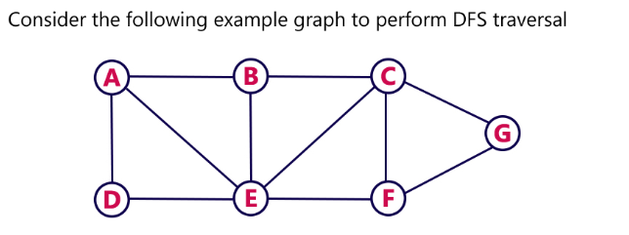
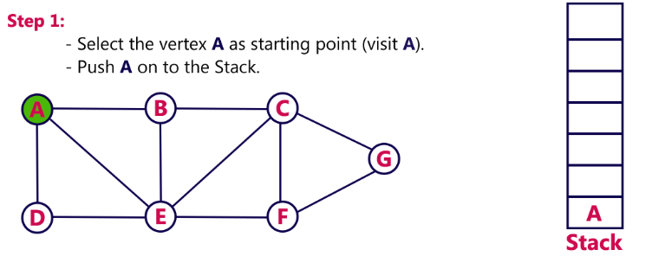
DFS Example

Slide 21
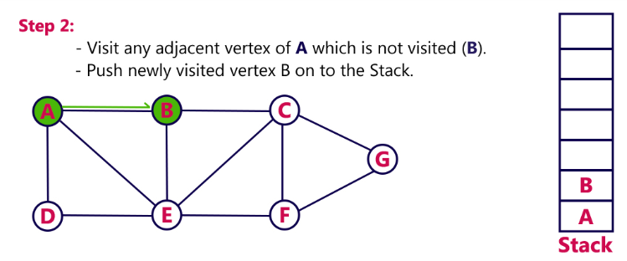
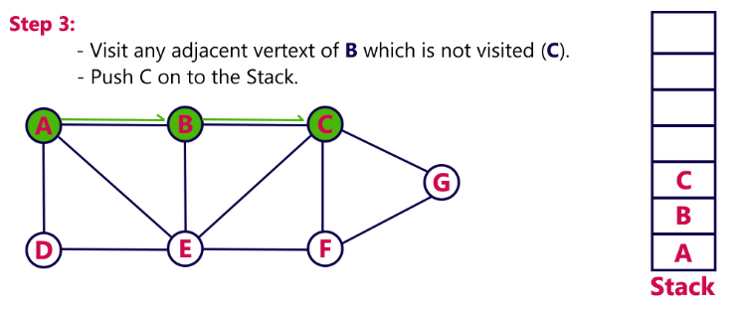
DFS Example

Slide 22
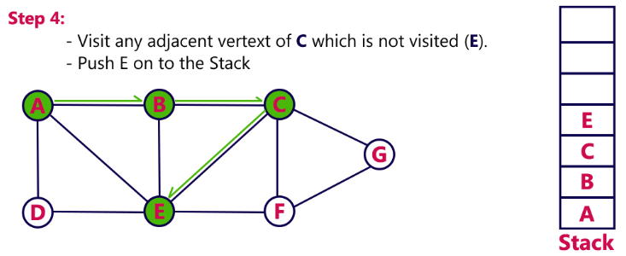
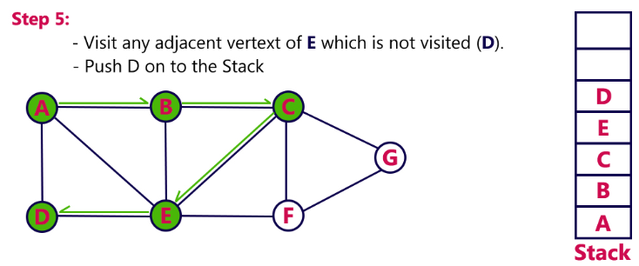
DFS Example

Slide 23
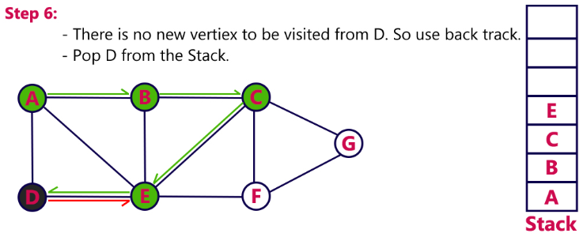
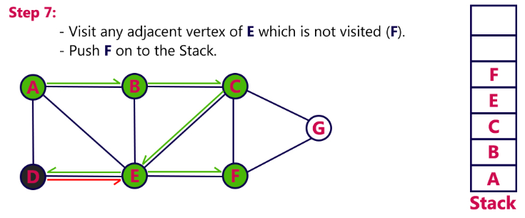
DFS Example

Slide 24
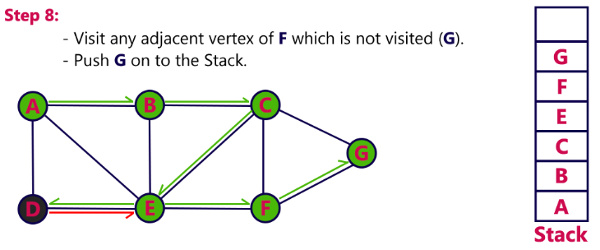
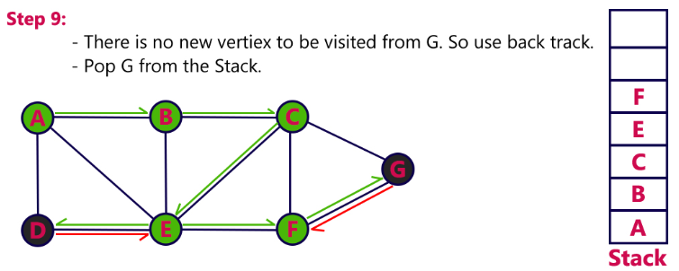
DFS Example

Slide 25
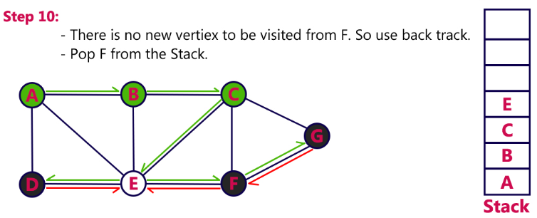
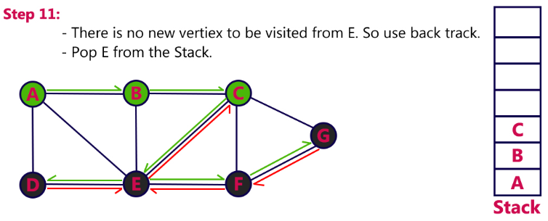
DFS Example

Slide 26
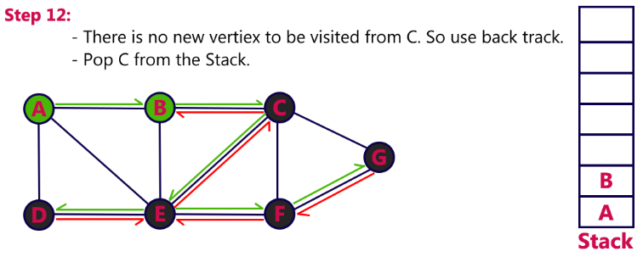
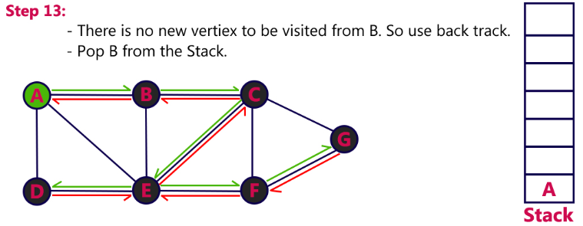
DFS Example

Slide 27
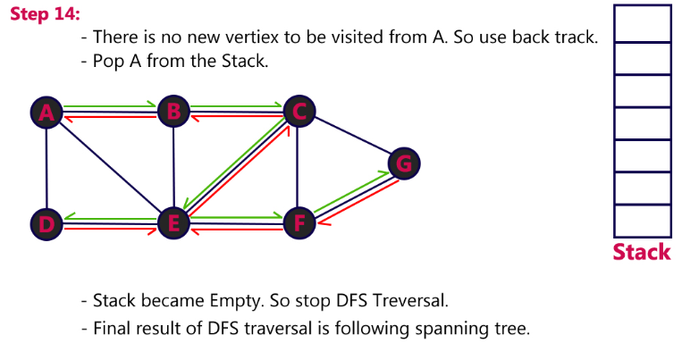
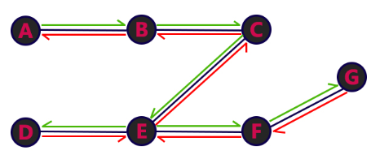
DFS Example

Slide 28
BFS (Breadth First Search)
BFS traversal of a graph produces a spanning tree as final result. Spanning Tree is a graph without loops.
Queue data structure with maximum size of total number of vertices in the graph is used to implement BFS traversal.
Steps for BFS traversal:
Step 1 - Define a Queue of size total number of vertices in the graph.
Step 2 - Select any vertex as starting point for traversal. Visit that vertex and insert it into the Queue.
Step 3 - Visit all the non-visited adjacent vertices of the vertex which is at front of the Queue and insert them into the Queue.
Step 4 - When there is no new vertex to be visited from the vertex which is at front of the Queue then delete that vertex.
Step 5 - Repeat steps 3 and 4 until queue becomes empty.
Step 6 - When queue becomes empty, then produce final spanning tree by removing unused edges from the graph

Slide 29
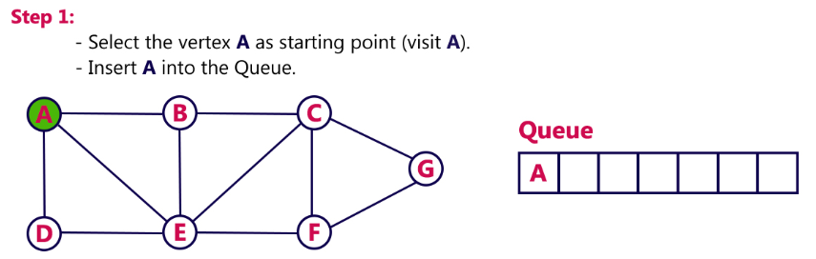
BFS Example

Slide 30
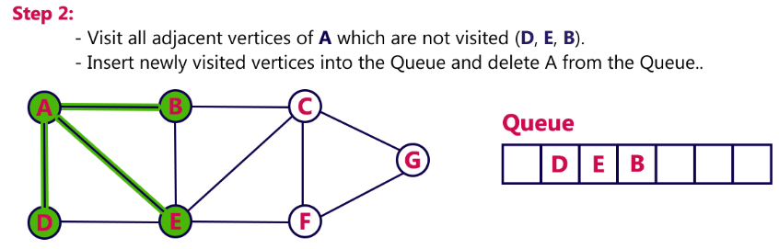
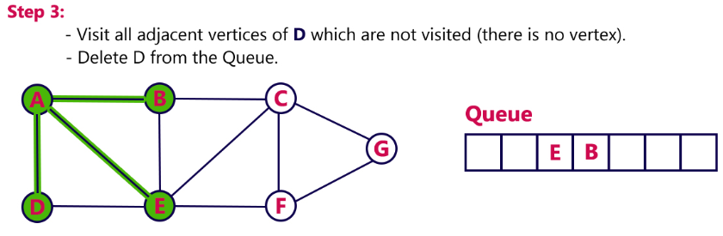
BFS Example

Slide 31
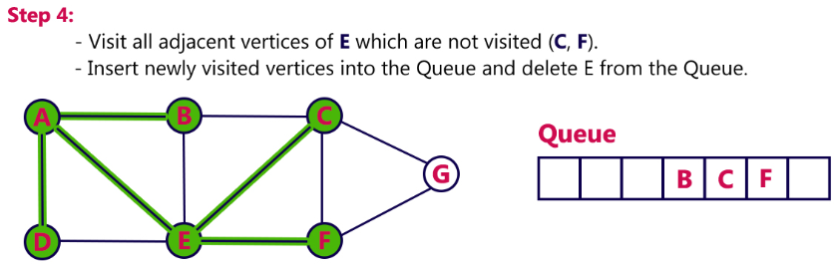
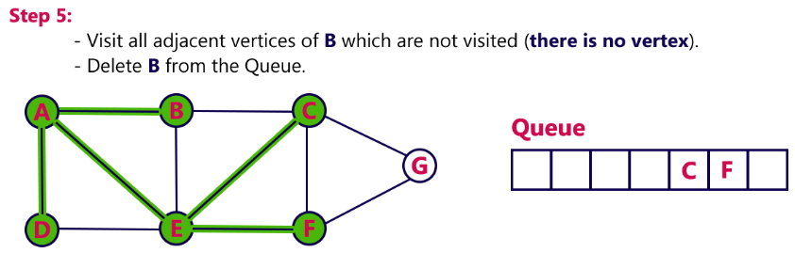
BFS Example

Slide 32
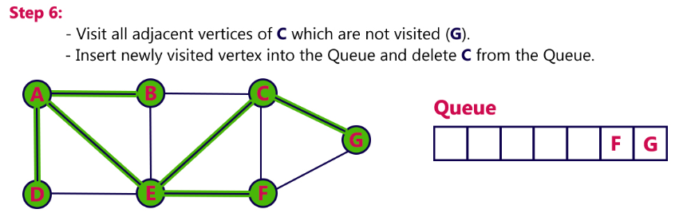
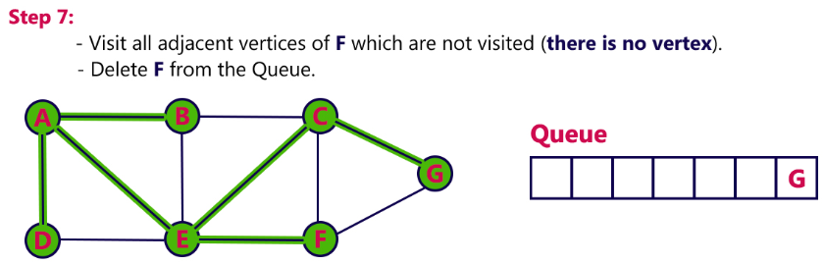
BFS Example

Slide 33
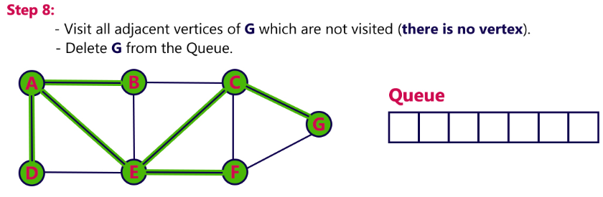
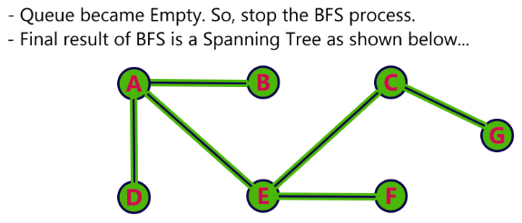
BFS Example

Slide 34
BFS vs DFS
 | BFS | DFS
Full form | BFS stands for Breadth First Search. | DFS stands for Depth First Search.
Technique | It a vertex-based technique to find the shortest path in a graph. | It is an edge-based technique because the vertices along the edge are explored first from the starting to the end node.
Definition | BFS is a traversal technique in which all the nodes of the same level are explored first, and then we move to the next level. | DFS is also a traversal technique in which traversal is started from the root node and explore the nodes as far as possible until we reach the node that has no unvisited adjacent nodes.

Slide 35
BFS vs DFS
Data Structure | Queue data structure is used for the BFS traversal. | Stack data structure is used for the BFS traversal.
Backtracking | BFS does not use the backtracking concept. | DFS uses backtracking to traverse all the unvisited nodes.
Number of edges | BFS finds the shortest path having a minimum number of edges to traverse from the source to the destination vertex. | In DFS, a greater number of edges are required to traverse from the source vertex to the destination vertex.
Optimality | BFS traversal is optimal for those vertices which are to be searched closer to the source vertex. | DFS traversal is optimal for those graphs in which solutions are away from the source vertex.

Slide 36
BFS vs DFS
Speed | BFS is slower than DFS. | DFS is faster than BFS.
Suitability for decision tree | It is not suitable for the decision tree because it requires exploring all the neighboring nodes first. | It is suitable for the decision tree. Based on the decision, it explores all the paths. When the goal is found, it stops its traversal.
Memory efficient | It is not memory efficient as it requires more memory than DFS. | It is memory efficient as it requires less memory than BFS

Slide 37
BFS Algorithm Applications
To build index by search index
For GPS navigation
Path finding algorithms
In Ford-Fulkerson algorithm to find maximum flow in a network
Cycle detection in an undirected graph
In minimum spanning tree

Slide 38
DFS Algorithm Applications
For finding the path
To test if the graph is bipartite
For finding the strongly connected components of a graph
For detecting cycles in a graph

Slide 39
Spanning tree
A Spanning tree can be defined as a subset of a graph, which consists of all the vertices covering minimum possible edges and does not have a cycle. Spanning tree cannot be disconnected.
Every connected and undirected graph has at least one spanning tree. A disconnected graph does not have a spanning tree as it is not possible to include all vertices.

Slide 40
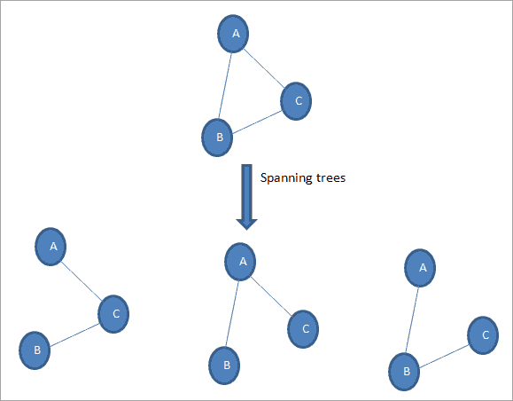
Spanning tree
In general, if N is the number of nodes in a graph, then a complete connected graph has maximum N^{N-2} number of spanning trees. Thus in the above graph N =3, therefore, it has 3⁽³⁻²⁾ = 3 spanning trees.

Slide 41
Properties of the spanning tree
A connected graph can have more than one spanning trees.
All spanning trees in a graph have the same number of nodes and edges.
If we remove one edge from the spanning tree, then it will become minimally connected and will make the graph disconnected.
On the other hand, adding one edge to the spanning tree will make it maximally acyclic thereby creating a loop.
A spanning tree does not have a loop or a cycle.

Slide 42
Minimum Spanning Tree (MST)
A minimum spanning tree is the one that contains the least weight among all the other spanning trees of a connected weighted graph.
There can be more than one minimum spanning tree for a graph.
There are two most popular algorithms that are used to find the minimum spanning tree in a graph.
Kruskal’s algorithm
Prim’s algorithm

Slide 43
Kruskal’s Algorithm
Kruskal’s algorithm is an algorithm to find the MST in a connected graph.
Kruskal’s algorithm finds a subset of a graph G such that:
It forms a tree with every vertex in it.
The sum of the weights is the minimum among all the spanning trees that can be formed from this graph.
The sequence of steps for Kruskal’s algorithm is given as follows:
First sort all the edges from the lowest weight to highest.
Take edge with the lowest weight and add it to the spanning tree. If the cycle is created, discard the edge.
Keep adding edges like in step 1 until all the vertices are considered.

Slide 44
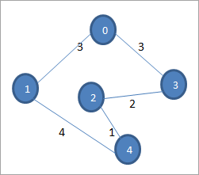
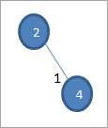
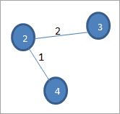
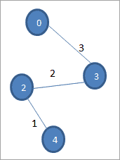
Kruskal’s Algorithm
Step 1: Select the edge with the least weight which is 2-4.
Step 2: Select the next shortest edge 2-3
Step 3: Select next edge with the shortest edge and that does not create a cycle i.e. 0-3

Slide 45
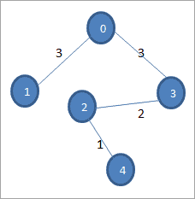
Kruskal’s Algorithm
Step 4: Select the shortest edge so that it doesn’t form a cycle. This is 0-1.

Slide 46
Prim’s Algorithm
Prim’s algorithm is yet another algorithm to find the minimum spanning the tree of a graph. In contrast to Kruskal’s algorithm that starts with graph edges, Prim’s algorithm starts with a vertex. We start with one vertex and keep on adding edges with the least weight till all the vertices are covered.
The sequence of steps for Prim’s Algorithm is as follows:
Choose a random vertex as starting vertex and initialize a minimum spanning tree.
Find the edges that connect to other vertices. Find the edge with minimum weight and add it to the spanning tree.
Repeat step 2 until the spanning tree is obtained.

Slide 47

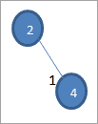
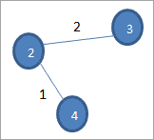
Prim’s Algorithm
Step 1: Select node 2 as the random vertex.
Step 2: Select the edge with the least weight from 2. We choose edge 2-4
Step 3: Select another vertex that is not in the spanning tree yet. We choose the edge 2-3.

Slide 48


Prim’s Algorithm
Step 4: Select an edge with least weight from the above vertices. We have edge 3-0 which has the least weight.
Step 5: Select an edge with the least weight from vertex 0. This is the edge 0-1.
Covered all the vertices in the graph and obtained a complete spanning tree with minimum cost.

Slide 49
Prim’s vs. Kruskal’s algorithm
Prim’s Algorithm | Kruskal’s Algorithm
It starts to build the Minimum Spanning Tree from any vertex in the graph. | It starts to build the Minimum Spanning Tree from the vertex carrying minimum weight in the graph.
It traverses one node more than one time to get the minimum distance. | It traverses one node only once.
Prim’s algorithm has a time complexity of O(V²), V being the number of vertices and can be improved up to O(E log V) using Fibonacci heaps. | Kruskal’s algorithm’s time complexity is O(E log V), V being the number of vertices.

Slide 50
Prim’s vs. Kruskal’s algorithm
Prim’s algorithm gives connected component as well as it works only on connected graph. | Kruskal’s algorithm can generate forest(disconnected components) at any instant as well as it can work on disconnected components
Prim’s algorithm runs faster in dense graphs. | Kruskal’s algorithm runs faster in sparse graphs.
It generates the minimum spanning tree starting from the root vertex. | It generates the minimum spanning tree starting from the least weighted edge.

Slide 51
Prim’s vs. Kruskal’s algorithm
Applications of prim’s algorithm are Travelling Salesman Problem, Network for roads and Rail tracks connecting all the cities etc. | Applications of Kruskal algorithm are LAN connection, TV Network etc.
Prim’s algorithm prefer list data structures. | Kruskal’s algorithm prefer heap data structures.

Slide 52

Example

Slide 53
Applications Of Spanning Tree
Communications Network Setup: When we want to set up a communication network using communication links, then the cost of setting up communication links between two points is best determined using an MST.
Cluster Analysis: It can be used to solve the K-clustering problem by finding a minimum spanning tree and deleting the k-1 most expensive edges.
Laying Out Road/Rail Networks: When we lay various road or rail networks between or within cities, the cost of the project is a very important factor. We can find the best path with minimum cost using minimum spanning trees.
Planning Housing Facilities: Facilities like electricity, water, sewage, etc. to be provided to a number of houses also require to be at optimum cost and this is done using an MST.
Solving the Travelling Salesman Problem: We can use an MST to solve the traveling salesman problem which requires to visit each point at least once.

Slide 54
Shortest Path Algorithms: Single Source All destinations, all pair shortest path algorithm, Topological Sort.

Slide 55
Shortest Path Algorithms
The shortest path problem is about finding a path between 2 vertices in a graph such that the total sum of the edges weights is minimum.
This problem could be solved easily using (BFS) if all edge weights were (1), but here weights can take any value.

Slide 56
Shortest Path Algorithms
Three different algorithms on the use-case
Bellman Ford's Algorithm- Bellman Ford's algorithm is used to find the shortest paths from the source vertex to all other vertices in a weighted graph.
Dijkstra's Algorithm- Dijkstra's algorithm has many variants but the most common one is to find the shortest paths from the source vertex to all other vertices in the graph
Floyd Warshall's Algorithm- Floyd or Warshall's Algorithm is used to find the shortest paths between between all pairs of vertices in a graph

Slide 57
Bellman Ford's Algorithm
Algorithm Steps:
The outer loop traverses from 0 : n−1.
Loop over all edges, check if the next node distance > current node distance + edge weight, in this case update the next node distance to "current node distance + edge weight".

Slide 58
Dijkstra's Algorithm-
Algorithm Steps:
Mark the source node with a current distance of 0 and the rest with infinity.
Set the non-visited node with the smallest current distance as the current node.
For each neighbor, N of the current node adds the current distance of the adjacent node with the weight of the edge connecting 0->1. If it is smaller than the current distance of Node, set it as the new current distance of N.
Mark the current node 1 as visited.
Go to step 2 if there are any nodes are unvisited

Slide 59

Dijkstra's Algorithm-

Slide 60

Dijkstra's Algorithm-

Slide 61

Floyd Warshall's Algorithm-

Slide 62

Floyd Warshall's Algorithm-

Slide 63

Floyd Warshall's Algorithm-

Slide 64

Floyd Warshall's Algorithm-

Slide 65

Floyd Warshall's Algorithm-

Slide 66

Floyd Warshall's Algorithm-

Slide 67
Topological Sorting
Topological sorting for Directed Acyclic Graph (DAG) is a linear ordering of vertices such that for every directed edge u v, vertex u comes before v in the ordering.
Note: Topological Sorting for a graph is not possible if the graph is not a DAG.

Slide 68

Topological Sorting
For example, a topological sorting of the following graph is “5 4 2 3 1 0”. There can be more than one topological sorting for a graph. Another topological sorting of the following graph is “4 5 2 3 1 0”. The first vertex in topological sorting is always a vertex with an in-degree of 0 (a vertex with no incoming edges).

Slide 69
Algorithm for Topological Sorting
Create a stack to store the nodes.
Initialize visited array of size N to keep the record of visited nodes.
Run a loop from 0 till N
if the node is not marked True in visited array
Call the recursive function for topological sort and perform the following steps.
Mark the current node as True in the visited array.
Run a loop on all the nodes which has a directed edge to the current node
if the node is not marked True in the visited array:
Recursively call the topological sort function on the node
Push the current node in the stack.
Print all the elements in the stack

Slide 70

Algorithm for Topological Sorting

